Slide 1


MEN'S CRICKET WORLD CUP 2023
(INDIA) MANAGEMENT SOFTWARE

Slide 2
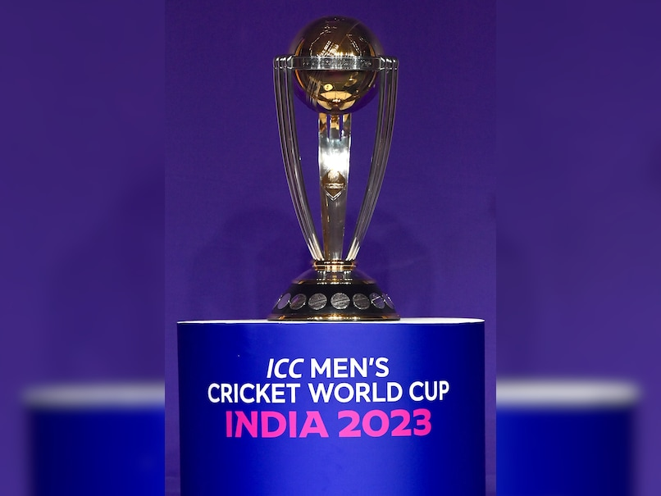
CREATED BY:
Mukul Aggarwal (MSD23007)
Sahil (MSD23009)
Aman Hayaat (MSD23005)
Sanu Vishwakarma (MSD23017)
Saurabh Kumar Singh (MSA23011)

Slide 3
SOFTWARE FEATURES

Slide 4
TWO TYPES OF LOGIN:
ADMIN LOGIN
TEAM LOGIN

Slide 5
FEATURES OF ADMIN LOGIN
SEE THE LIST OF ALL THE PLAYERS
SEE THE LIST OF ALL THE TEAMS
SEE THE LIST OF ALL THE VENUES
SEE THE LIST OF ALL THE FIXTURES
ADD A PLAYER
ADD A TEAM
ADD A VENUE
ADD A FIXTURE

Slide 6
FEATURES OF TEAM LOGIN
SEE THE CURRENT SQUAD.
SEE THE CURRENT PLAYING XI
CHANGE THE CURRENT PLAYING XI
SEE THE UPCOMING MATCHES WITH DETAILS
SEE ALL THE VENUES DETAILS.

Slide 7
A MENU DRIVEN TRIAL OF THE SOFTWARE

Slide 8
PROGRAM FLOWCHARTS

Slide 9
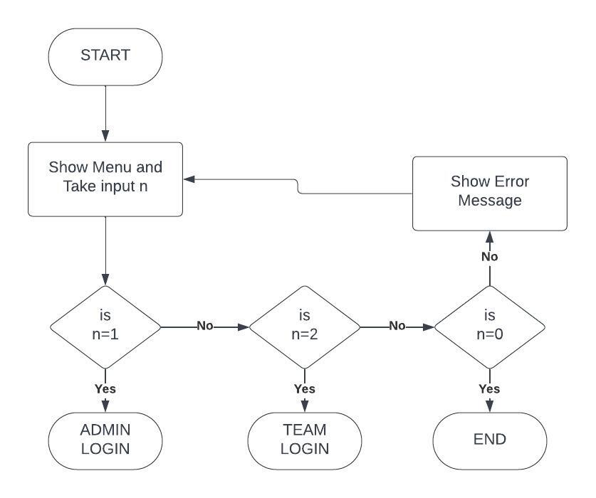
MAIN FUNCTION

Slide 10
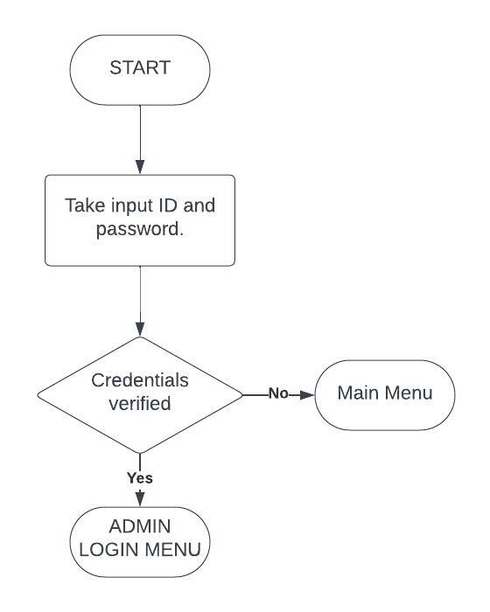

ADMIN LOGIN FUNCTION
TEAM LOGIN FUNCTION

Slide 11
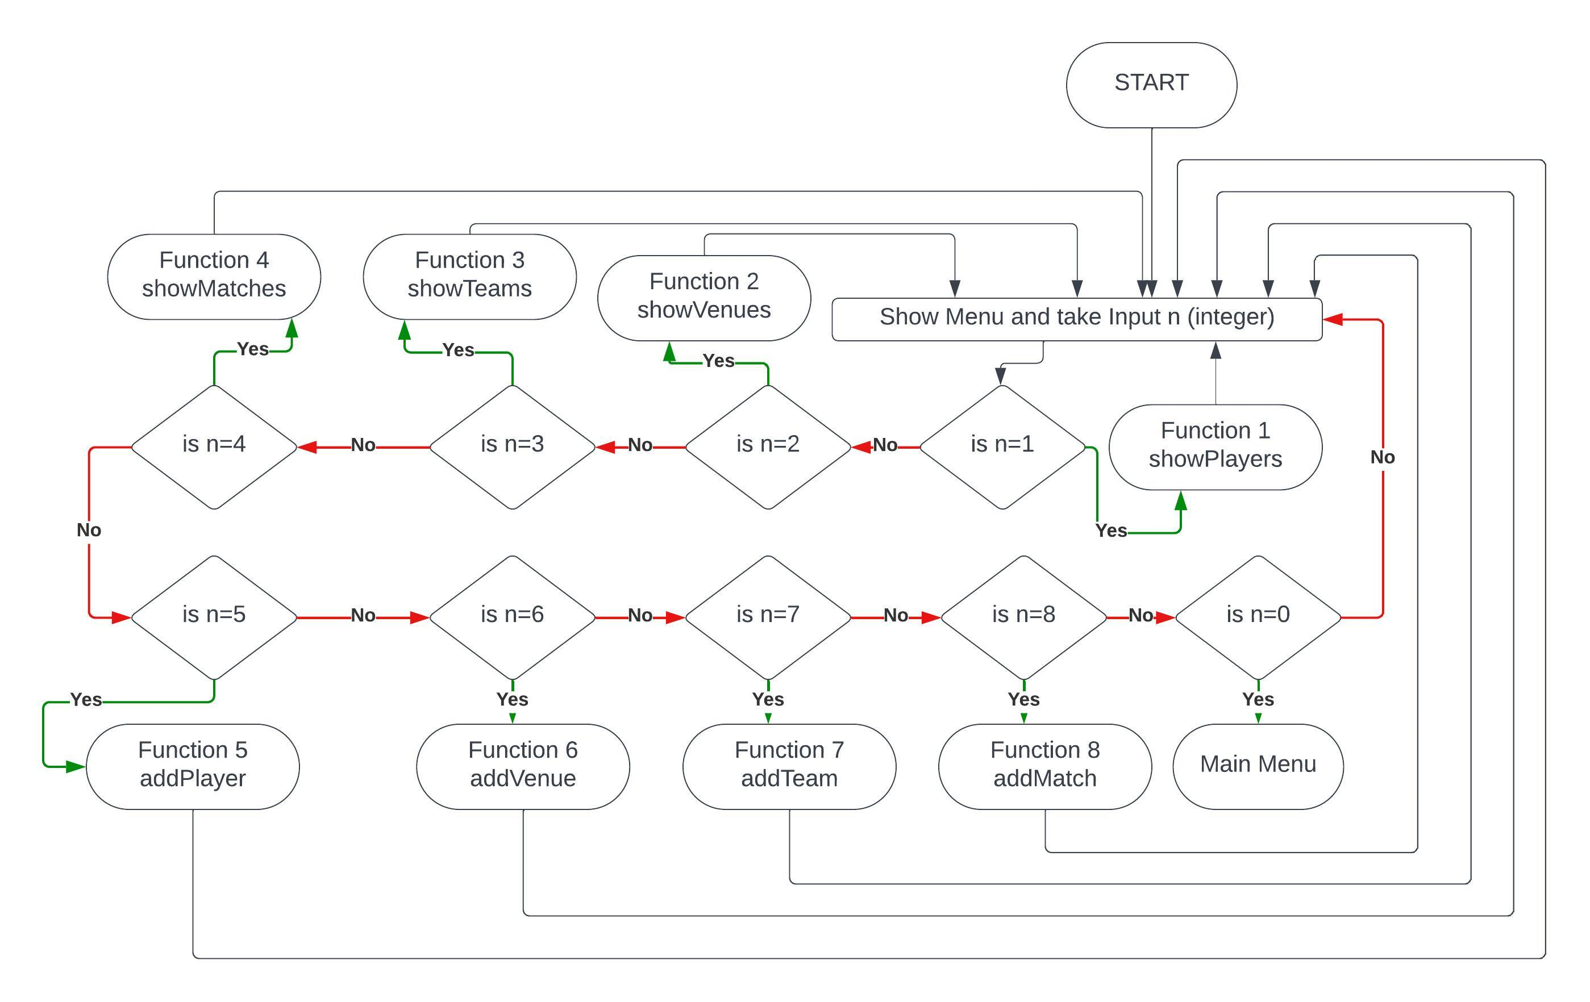
ADMIN LOGIN MENU FUNCTION

Slide 12
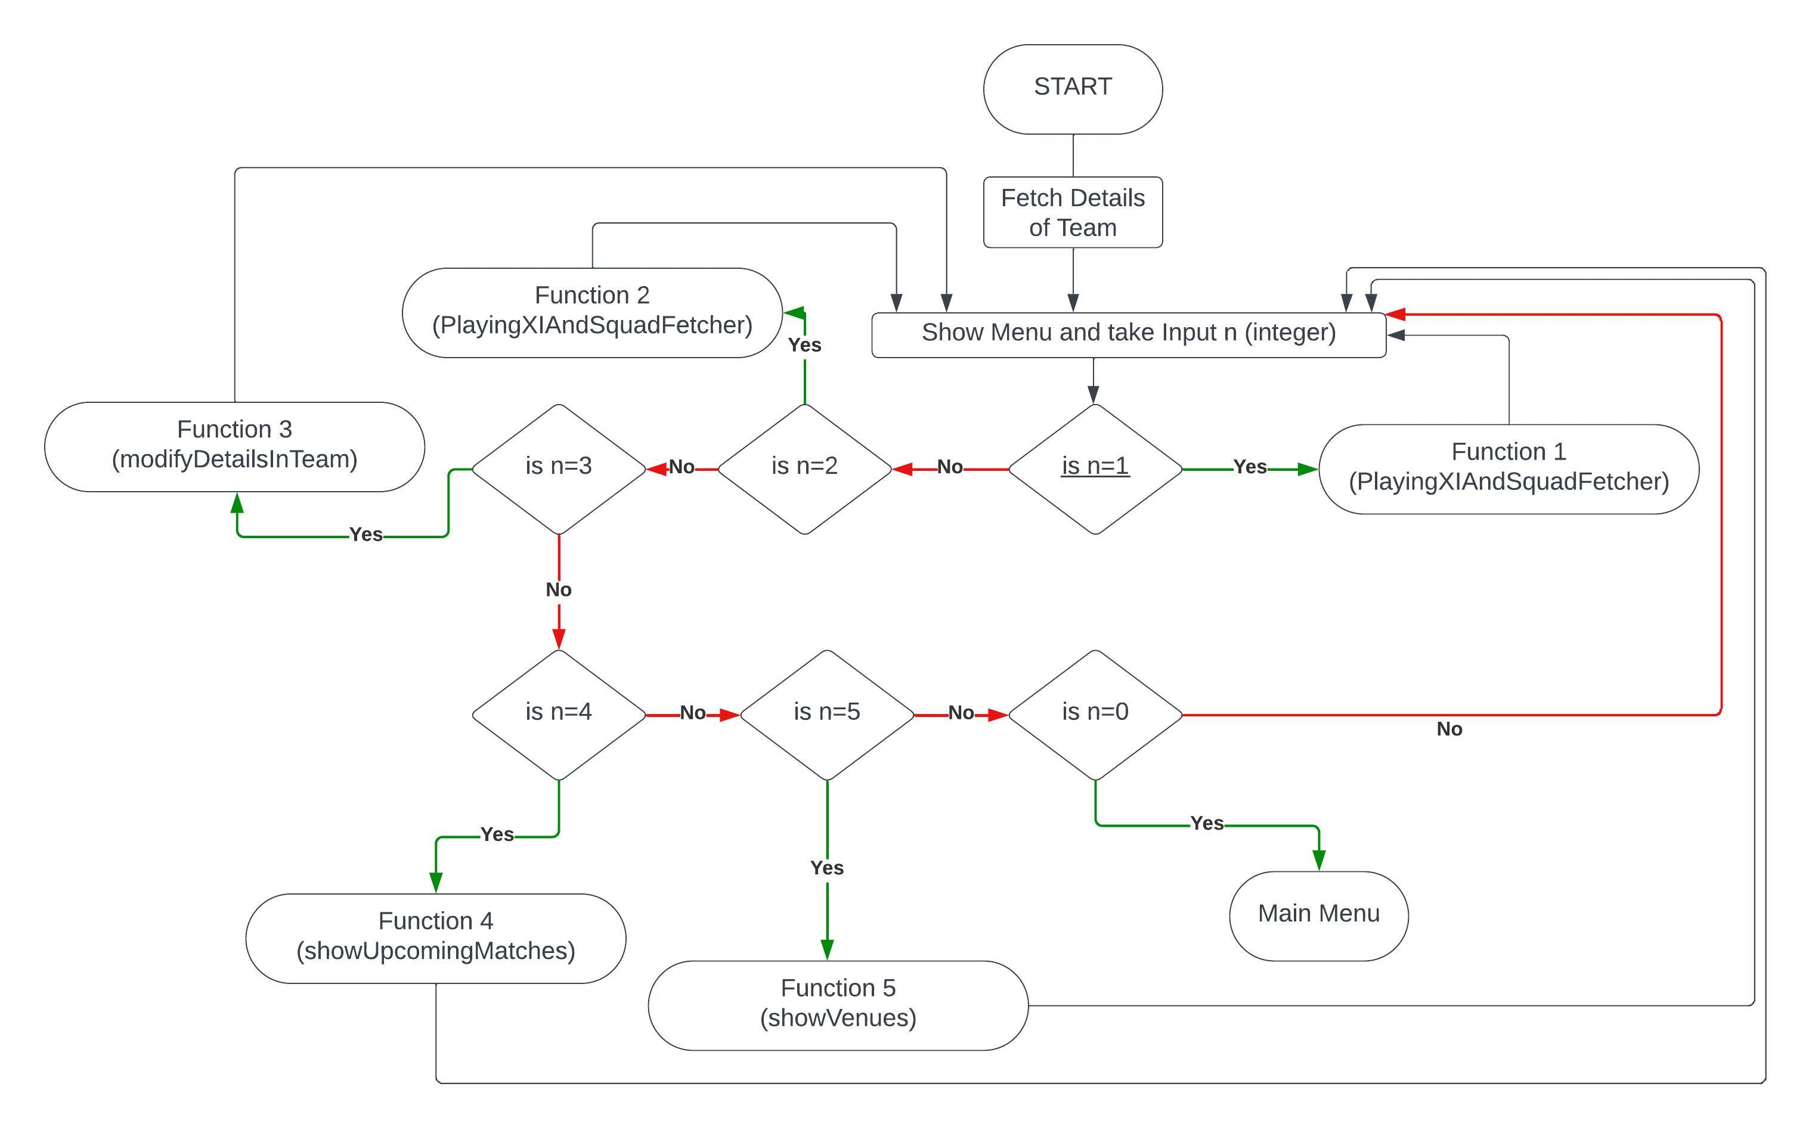
TEAM LOGIN MENU FUNCTION

Slide 13
CLASSES USED IN THIS PROGRAM

Slide 14
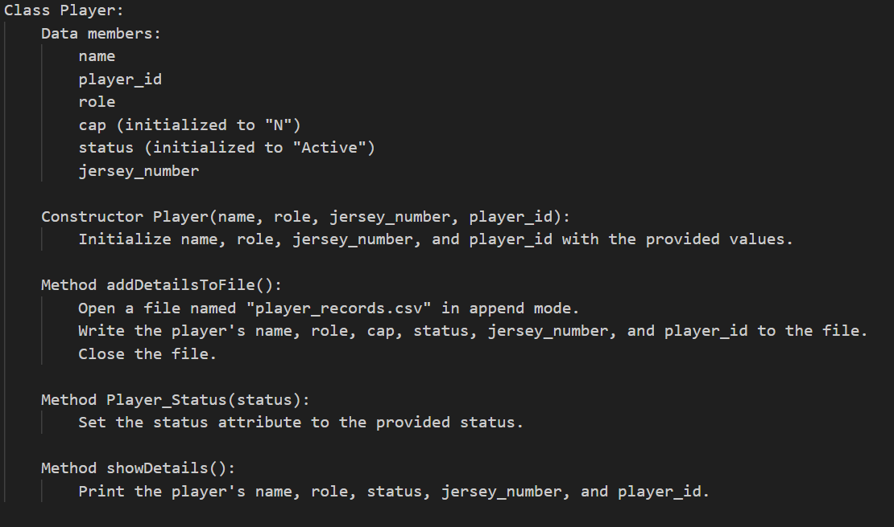

Slide 15
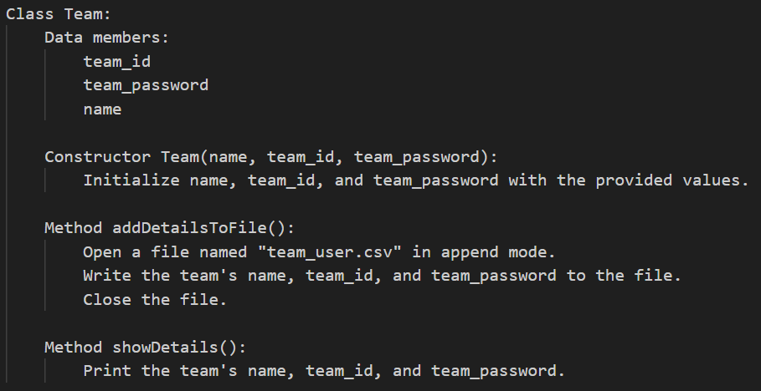

Slide 16
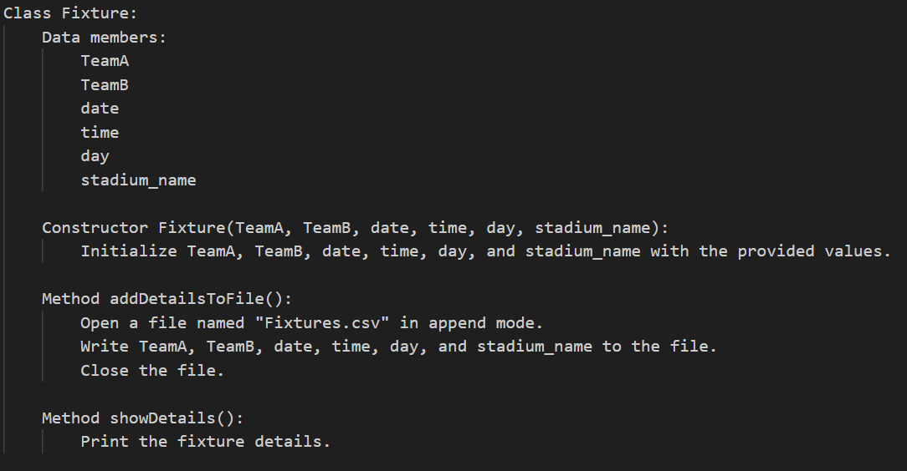

Slide 17
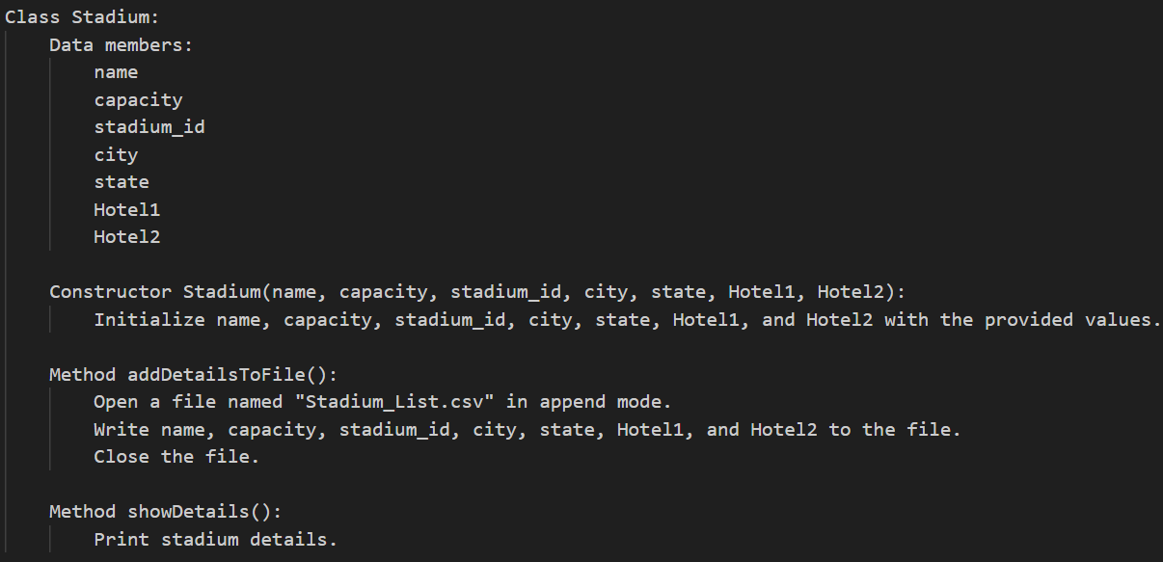

Slide 18
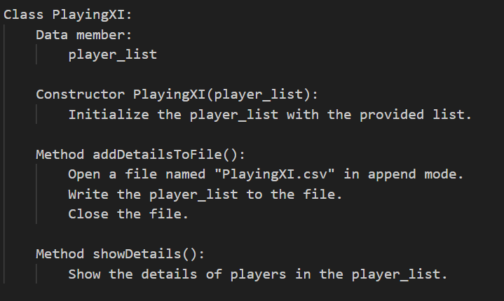

Slide 19
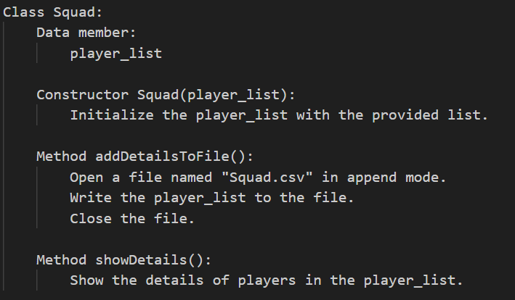

Slide 20
SNAPSHOTS OF DATABASE TABLES

Slide 21
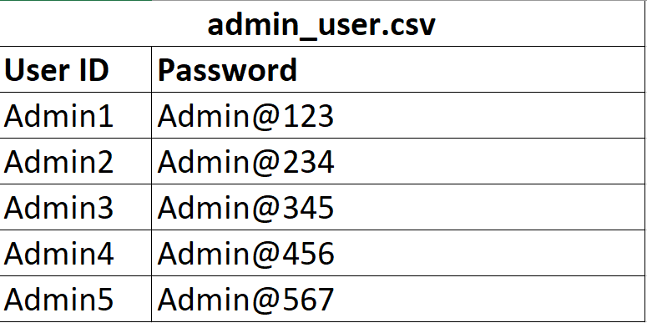
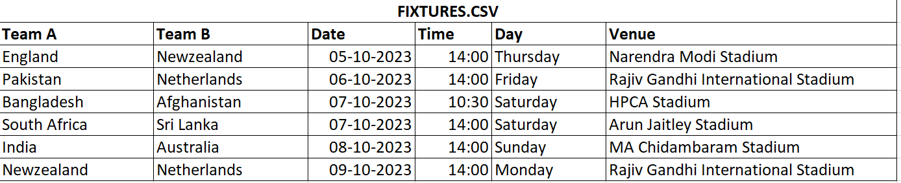

Slide 22
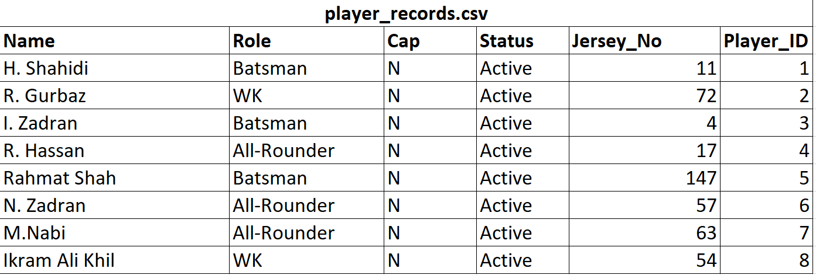

Slide 23
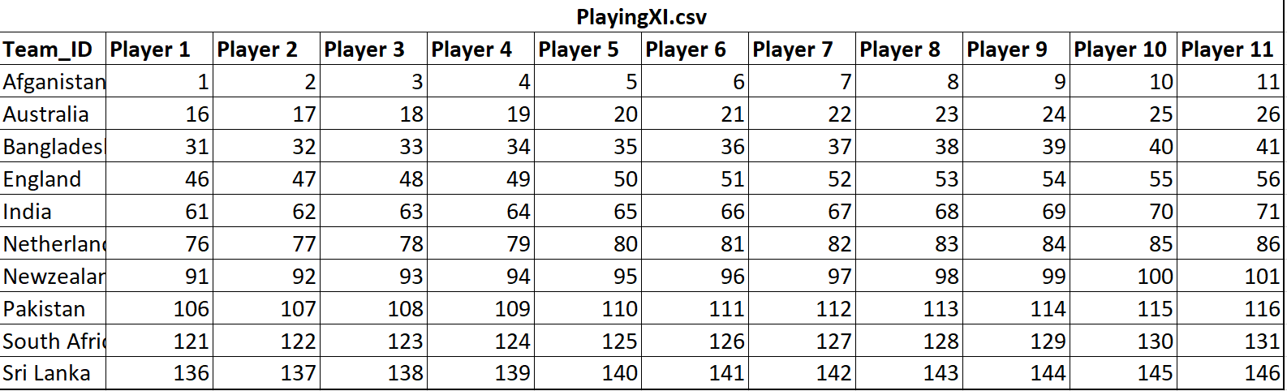

Slide 24
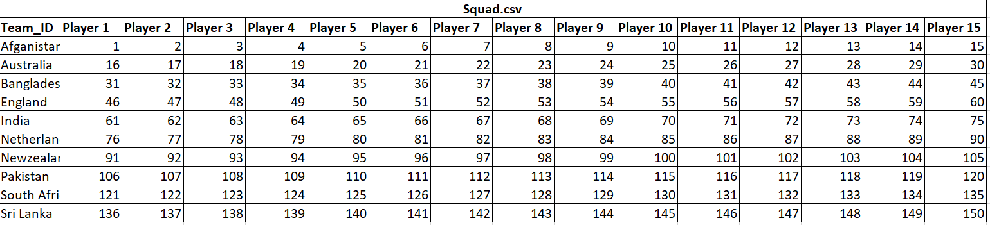

Slide 25
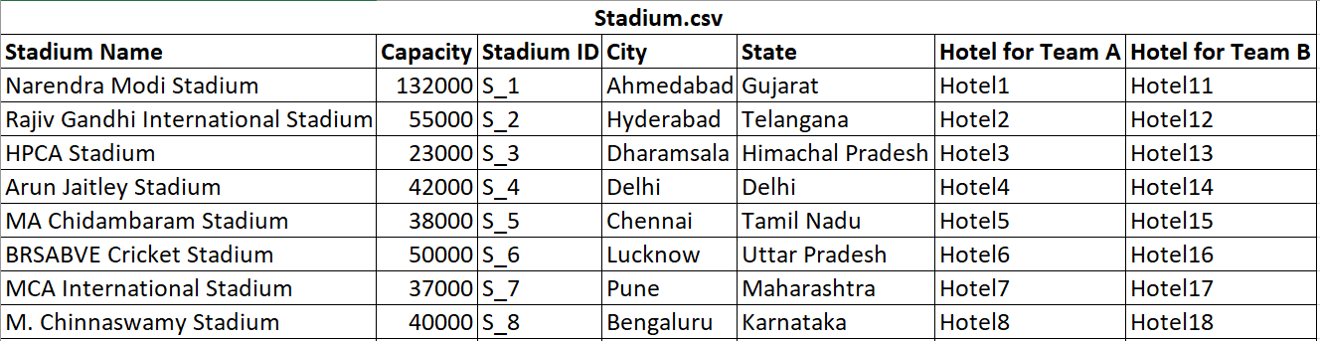
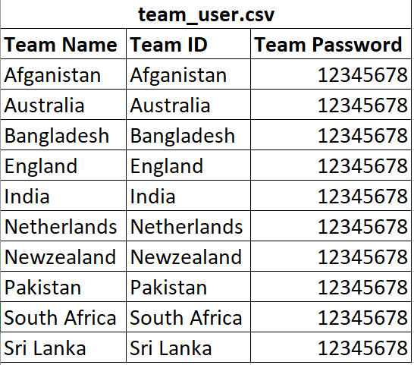

Slide 26
SOME PSUEDOCODES

Slide 27
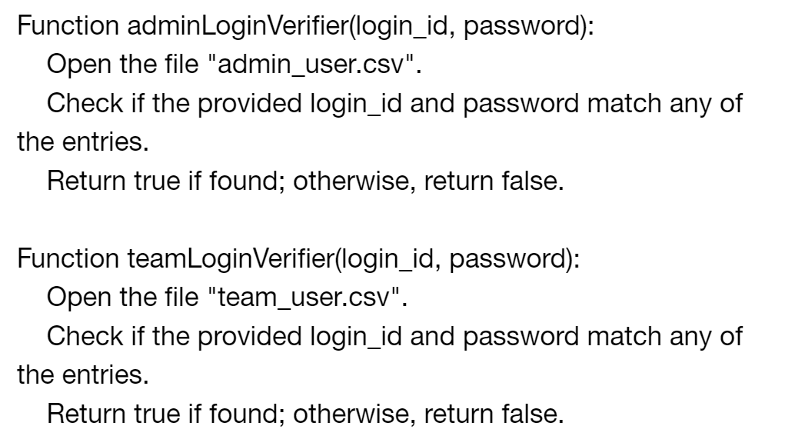

Slide 28
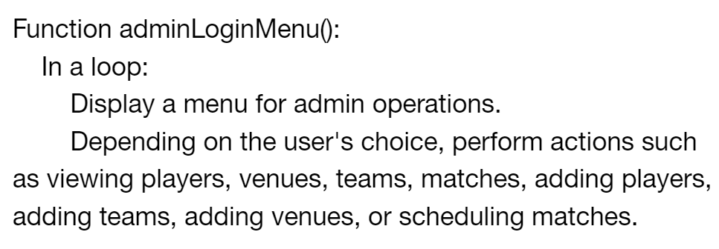
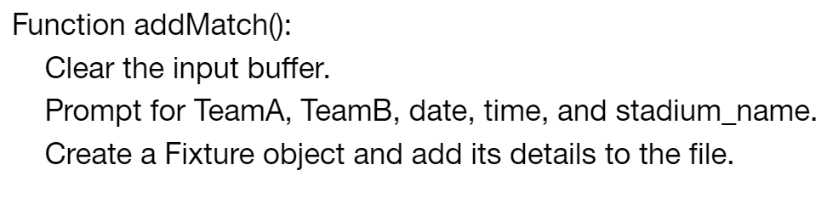

Slide 29
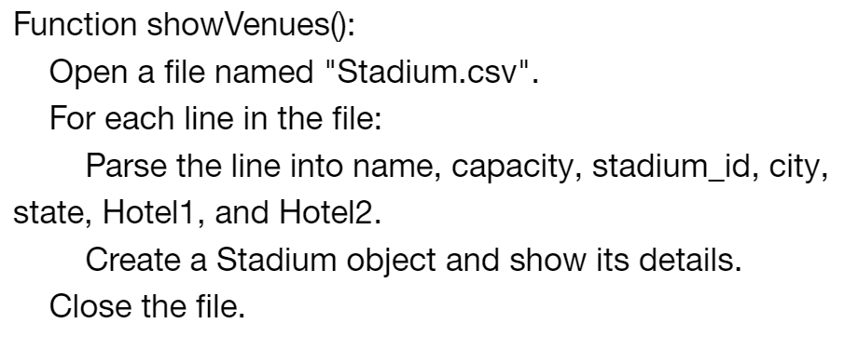

Slide 30
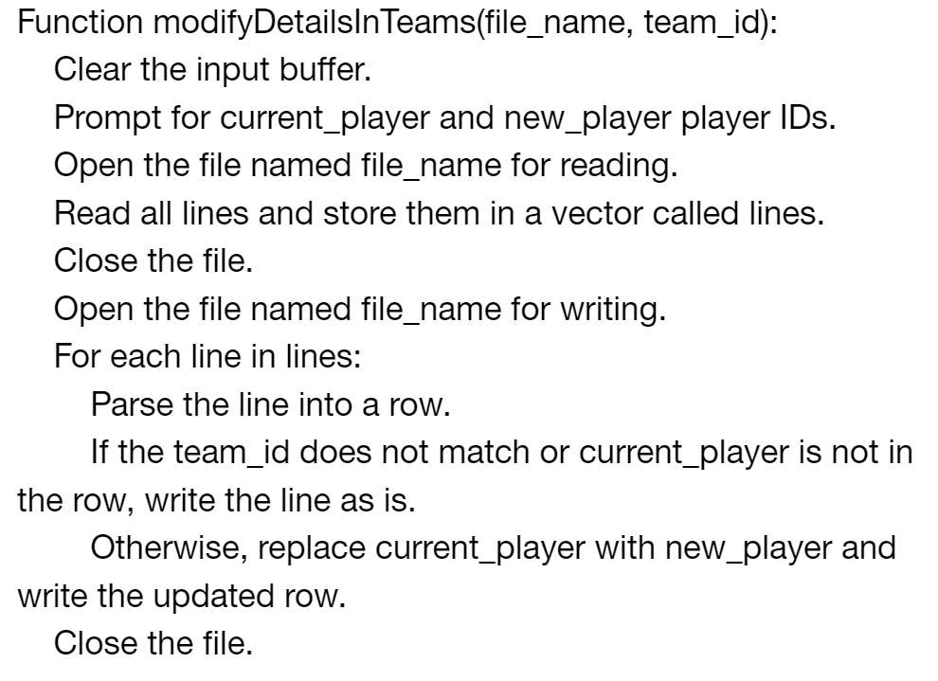

Slide 31
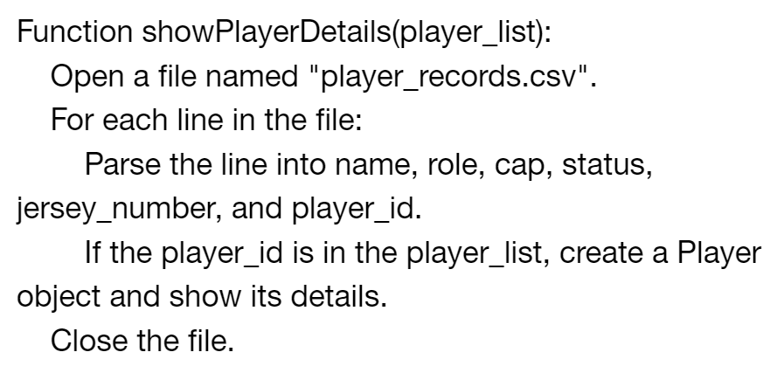

Slide 32
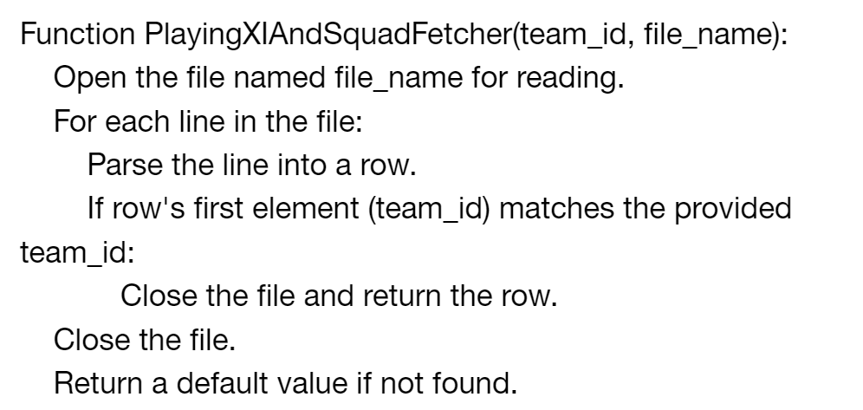

Slide 33
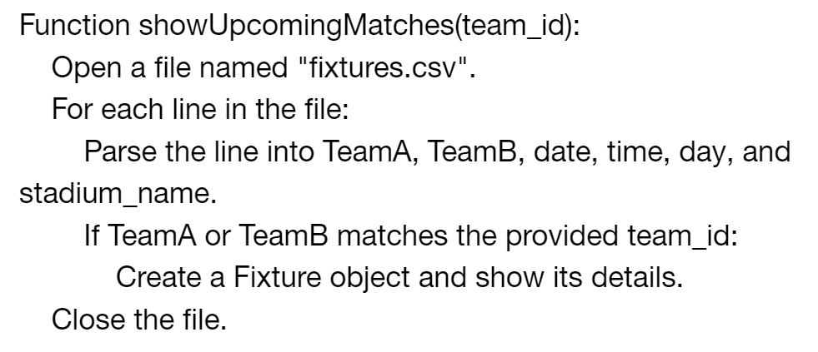

Download Complete Pseudocode File Here:
https://drive.google.com/file/d/1FrKAix4ND9ynSVVmstP73bPdxlQ3L_6z/view?usp=drive_link

Slide 34
HERE ARE SOME USER INTERFACES FOR THIS SOFTWARE

Slide 35
1. MAIN MENU

Slide 36
Cricket World Cup 2023 Management System
ADMIN
LOGIN
TEAM
LOGIN

Slide 37
2. ADMIN LOGIN

Slide 38
ADMIN LOGIN
Enter Login ID Here
Password
LOGIN

Slide 39
3. ADMIN MENU

Slide 40
HI ADMIN!
Welcome to Men's Cricket World cup 2023
ALL PLAYERS
ADD A TEAM
ALL TEAMS
ADD A VENUE
ALL VENUES
SCHEDULE A FIXTURE
ALL FIXTURES
ADD A PLAYER

Slide 41
4. CHECKING THE LIST OF PLAYERS

Slide 42
LIST OF ALL PLAYERS
PLAYER NAME | ROLE | CAP | STATUS | JERSEY NUMBER | PLAYER ID
Rohit Sharma | Batsman | Captain | Active | 45 | 61
H.Pandya | All-Rounder | Vice Captain | Injured | 79 | 62
Shubman Gill | Batsman | Normal | Active | 68 | 63
Virat Kohli | Batsman | Normal | Active | 18 | 64
Shreyas Iyer | Batsman | Normal | Active | 61 | 65
KL Rahul | WK | Normal | Active | 28 | 66
R.Jadeja | All-Rounder | Normal | Active | 17 | 67
R.Ashwin | All-Rounder | Normal | Active | 99 | 68
Shardul Thakur | Bowler | Normal | Active | 39 | 69
1
2
3
---------
19
NEXT PAGE

Slide 43
5. ADDING A PLAYER

Slide 44
ADD A PLAYER
Enter Player Name
Enter Player ID
Enter Player Role
Enter Player Jersey Number
ADD

Slide 45
6. TEAM LOGIN

Slide 46
TEAM LOGIN
Enter Team ID Here
Password
LOGIN

Slide 47
7. TEAM MENU

Slide 48
NAMASTE AUSTRALIA!
Welcome to Men's Cricket World cup 2023
FULL SQUAD
PLAYING XI
CHANGE PLAYING XI
UPCOMING MATCHES
VISIT STADIUMS

Slide 49
8. CHECKING THE SQUAD

Slide 50
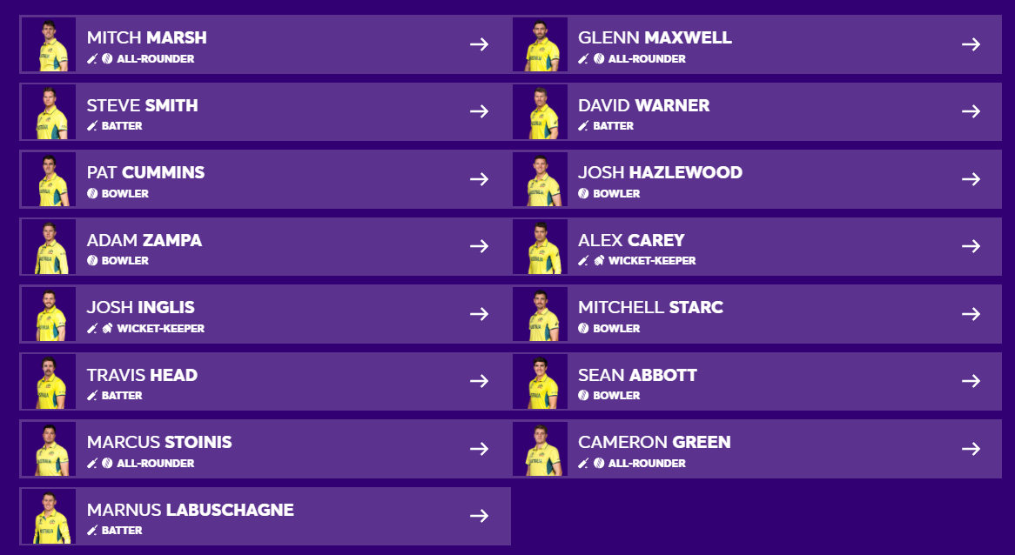
AUSTRALIA SQUAD

Slide 51
9. CHECKING THE PLAYING XI

Slide 52
AUSTRALIA PLAYING XI

Slide 53
10. CHANGING THE PLAYING XI

Slide 54
CHANGE PLAYING XI
Drag Players to move from one box to another.
Remaining Players
SUBMIT
PLAYING XI

Slide 55
THANK YOU!

